Slide 1


Edwards & Avey Investments
Edwards and Avey Investments is your go-to solution for tailored investment bundles. We offer up-to-the-day investment opportunities in groups of assets provided by our highly-experienced partners. These partners collate groups of relevant assets into investment “ideas”. These ideas make it easy for you as an investor to find collections of individual assets that meet your desired investment interests, without the need to personally hand pick them, saving you time and allowing you to grow your investment portfolio much faster, and easier.
Log in

Slide 2
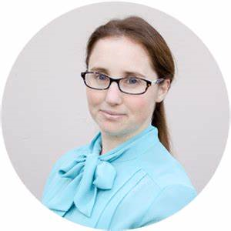
Edwards & Avey Investments
Edwards and Avey Investments is your go-to solution for tailored investment bundles. We offer up-to-the-day investment opportunities in groups of assets provided by our highly-experienced partners. These partners collate groups of relevant assets into investment “ideas”. These ideas make it easy for you as an investor to find collections of individual assets that meet your desired investment interests, without the need to personally hand pick them, saving you time and allowing you to grow your investment portfolio much faster, and easier.
Client
Edit Profile
Home
View Suggested Ideas
Logout

Slide 3
Preferences
Investment Types
Risk level (max)
Currencies
Regions
Profile Picture
Client
Precious Metals
Renewable Energy
Bonds
Precious Metals
Edit Profile
Add
Remove
Home
View Suggested Ideas
Logout
3
Change
GBP, USD, AUD, YEN
AED
Add
Remove
Europe
North America
Africa
Middle East
Add
Remove
Save Changes

Slide 4
Suggested Ideas
Title
Ecologically sound construction investments in the UK and Western Europe
Overview
Enim ut sem viverra aliquet eget. Aliquam vestibulum morbi blandit cursus risus at ultrices mi tempus. Risus at ultrices mi tempus imperdiet. Interdum consectetur libero id faucibus nisl tincidunt. Ornare arcu dui vivamus arcu felis bibendum ut. Sit amet dictum sit amet.
Risk Level
3
Product Type
Infrastructural investment, Industry investment, Renewable energies
Currency
GBP, EU
Region
Europe
Country
United Kingdom, France, Germany
Major Sector
Construction, Energy
Minor Sector
Fabrication, Materials processing, Bricklaying, Plumbing
Instruments
CON, FBR, ANC, WKP, LOL
Published
13/02/22
Expires
01/01/23
Author
Bret Harrington
Content
Cras adipiscing enim eu turpis egestas. Commodo ullamcorper a lacus vestibulum sed. Eu facilisis sed odio morbi quis. Nibh praesent tristique magna sit amet purus gravida. Habitant morbi tristique senectus et netus et malesuada. Ultrices in iaculis nunc sed. Gravida in fermentum et sollicitudin ac orci phasellus egestas tellus.
Enim ut sem viverra aliquet eget. Aliquam vestibulum morbi blandit cursus risus at ultrices mi tempus. Risus at ultrices mi tempus imperdiet. Interdum consectetur libero id faucibus nisl tincidunt. Ornare arcu dui vivamus arcu felis bibendum ut. Sit amet dictum sit amet. Nisi vitae suscipit tellus mauris. Ipsum nunc aliquet bibendum enim.
Title
Ecologically sound construction investments in the UK and Western Europe
Overview
Enim ut sem viverra aliquet eget. Aliquam vestibulum morbi blandit cursus risus at ultrices mi tempus. Risus at ultrices mi tempus imperdiet. Interdum consectetur libero id faucibus nisl tincidunt. Ornare arcu dui vivamus arcu felis bibendum ut. Sit amet dictum sit amet.
Risk Level
3
Product Type
Infrastructural investment, Industry investment, Renewable energies
Currency
GBP, EU
Region
Europe
Country
United Kingdom, France, Germany
Major Sector
Construction, Energy
Minor Sector
Fabrication, Materials processing, Bricklaying, Plumbing
Instruments
CON, FBR, ANC, WKP, LOL
Published
13/02/22
Expires
01/01/23
Author
Bret Harrington
Content
Cras adipiscing enim eu turpis egestas. Commodo ullamcorper a lacus vestibulum sed. Eu facilisis sed odio morbi quis. Nibh praesent tristique magna sit amet purus gravida. Habitant morbi tristique senectus et netus et malesuada. Ultrices in iaculis nunc sed. Gravida in fermentum et sollicitudin ac orci phasellus egestas tellus.
Enim ut sem viverra aliquet eget. Aliquam vestibulum morbi blandit cursus risus at ultrices mi tempus. Risus at ultrices mi tempus imperdiet. Interdum consectetur libero id faucibus nisl tincidunt. Ornare arcu dui vivamus arcu felis bibendum ut. Sit amet dictum sit amet. Nisi vitae suscipit tellus mauris. Ipsum nunc aliquet bibendum enim.
Client
Edit Profile
Home
View Suggested Ideas
Logout
Approve
Remove
Approve
Remove

Slide 5
Edwards & Avey Investments
Edwards and Avey Investments is your go-to solution for tailored investment bundles. We offer up-to-the-day investment opportunities in groups of assets provided by our highly-experienced partners. These partners collate groups of relevant assets into investment “ideas”. These ideas make it easy for you as an investor to find collections of individual assets that meet your desired investment interests, without the need to personally hand pick them, saving you time and allowing you to grow your investment portfolio much faster, and easier.
Log in

Slide 6
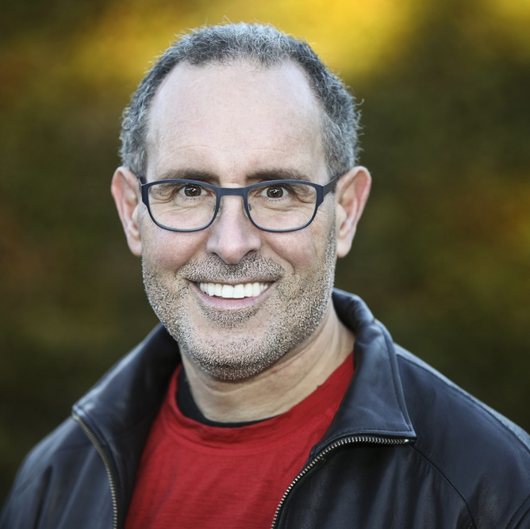
Edwards & Avey Investments
Edwards and Avey Investments is your go-to solution for tailored investment bundles. We offer up-to-the-day investment opportunities in groups of assets provided by our highly-experienced partners. These partners collate groups of relevant assets into investment “ideas”. These ideas make it easy for you as an investor to find collections of individual assets that meet your desired investment interests, without the need to personally hand pick them, saving you time and allowing you to grow your investment portfolio much faster, and easier.
RM
Edit Profile
Home
View Ideas
View Clients
Create User
Logout

Slide 7
Ideas
Ecologically sound construction investments in the UK and Western Europe
Precious metals of Eurasia
Emerging Cryptocurrencies of the Americas
Ecologically sound construction investments in the UK and Western Europe
RM
Edit Profile
Content
Cras adipiscing enim eu turpis egestas. Commodo ullamcorper a lacus vestibulum sed. Eu facilisis sed odio morbi quis. Nibh praesent tristique magna sit amet purus gravida. Habitant morbi tristique senectus et netus et malesuada. Ultrices in iaculis nunc sed. Gravida in fermentum et sollicitudin ac orci phasellus egestas tellus.
Enim ut sem viverra aliquet eget. Aliquam vestibulum morbi blandit cursus risus at ultrices mi tempus. Risus at ultrices mi tempus imperdiet. Interdum consectetur libero id faucibus nisl tincidunt. Ornare arcu dui vivamus arcu felis bibendum ut. Sit amet dictum sit amet. Nisi vitae
Home
View Ideas
View Clients
Create User
Logout
See full details
Clients
Donald McLaughlin – 100% match
Gerry Adams – 100% match
Peter Molyneux – 84% match
Janice Framingham – 80% match
Beverley Hyacinth – 72% match
John Omutwanga – 66% match
Sarah Donaghy – 65% match
Donald McLaughlin – 100% match
Suggest idea – Donald McLaughlin

Slide 8
Clients
Gerry Adams
Sarah Donaghy
Janice Framingham
Beverley Hyacinth
Donald McLaughlin
Peter Molyneux
John Omutwanga
Gerry Adams
RM
Edit Profile
Home
View Ideas
View Clients
Create User
See Preferences
Logout
Ideas
Ecologically sound construction investments in the UK and Western Europe – 98% match
Ecologically sound construction investments in the UK and Western Europe – 98% match
Precious metals of Eurasia – 86% match
Emerging Cryptocurrencies of the Americas – 72% match
Small business loans for North-African entrepreneurs – 66% match
Diverse European bonds package – 52% match
American tech giant stocks – 52% match
Business loans for STEM startups in Canada – 42% match
Suggest Idea

Slide 9

RM
Edit Profile
Home
View Ideas
View Clients
Account Type
Create User
Username
Logout
Password
Create Account

Slide 10
Edwards & Avey Investments
Edwards and Avey Investments is your go-to solution for tailored investment bundles. We offer up-to-the-day investment opportunities in groups of assets provided by our highly-experienced partners. These partners collate groups of relevant assets into investment “ideas”. These ideas make it easy for you as an investor to find collections of individual assets that meet your desired investment interests, without the need to personally hand pick them, saving you time and allowing you to grow your investment portfolio much faster, and easier.
Log in

Slide 11
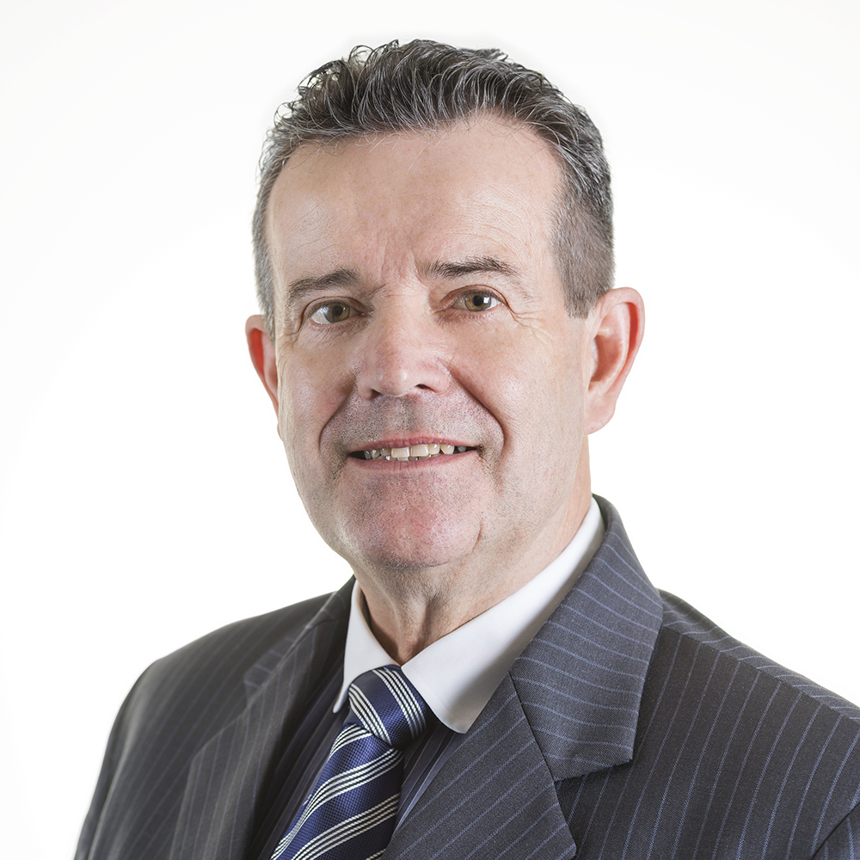
Edwards & Avey Investments
Edwards and Avey Investments is your go-to solution for tailored investment bundles. We offer up-to-the-day investment opportunities in groups of assets provided by our highly-experienced partners. These partners collate groups of relevant assets into investment “ideas”. These ideas make it easy for you as an investor to find collections of individual assets that meet your desired investment interests, without the need to personally hand pick them, saving you time and allowing you to grow your investment portfolio much faster, and easier.
FA
Edit Profile
Home
Create Idea
Logout

Slide 12
Filters
Industry Sector - Major
FA
Technology
Healthcare
Financials
Financials
Technology
Healthcare
Edit Profile
Add
Remove
Home
Industry Sector - Minor
Gaming
Renewable Energies
Pharmaceuticals
Bonds
Pharmaceuticals
Create Idea
Gaming
Renewable Energies
Pharmaceuticals
Bonds
Logout
Add
Remove
Currency
GBP
USD
EUR
AUD
Technology
Healthcare
Add
Remove
Products
Huadong Instrument Stock
Amazon Web Services Stock
Atlantica Sustainable Green Notes
ChargePoint Holdings Common Stock
National Savings Bonds
German Government Bonds
Huadong Instrument Stock
Huadong Instrument Stock
Amazon Web Services Stock
Atlantica Sustainable Green Notes
ChargePoint Holdings Common Stock
Add
Remove

